Slide 1
Memory Hierarchy Design
(Appendix B and Chapter 2)

Slide 2
Outline
Review of the ABCs of Caches
Cache Performance
Reducing Cache Miss Penalty
Reducing Miss Rate
Reducing Cache Miss Penalty or Miss Rate via Parallelism
Reducing Hit Time
Memory Technology
Main Memory and Organization for Improving Performance
Virtual Memory

Slide 3
Review of the ABCs of Caches
When the CPU finds a requested data item in the cache,
it is called a cache hit. Otherwise, a cache miss occurs.
A fixed-size collection of data containing the requested
word, called a block, is retrieved from the main memory
and placed into the cache.

Slide 4
Cache Performance Review
Recall that CPU time can be computed by
IC
Clock Cycles
Seconds
CPU time =
×
×
Programs
IC
Clock Cycles
Total CPU clock cycles
Clock cycle time
IC= Instruction Count
This equation is valid only when CPU is not stalled
waiting for a memory access.

Slide 5
When we take the memory stall cycles into account, the
modified CPU time is given by
CPU time= (CPU clock cycles + Memory stalled cycles) × Clock cycle time
The number of memory stalled cycles depends on both the
number of misses and the cost per miss, which is called
the miss penalty:
Memory stalled cycles= Number of misses × Miss Penalty
Misses
=IC×
× Miss Penalty
IC
Memory accesses
=IC×
× Miss rate ×Miss Penalty
IC

Slide 6
The miss rate is defined as the fraction of cache accesses
that result in a miss (i.e., number of accesses that miss
divided by the number of accesses).
The miss rate is one of the most important measures of
cache design.

Slide 7
Example:
Assume we have a computer where the CPI is 1.0 when
all memory accesses hit in the cache. The only data
accesses are loads and stores, and these total 50% of the
instructions. If the miss penalty is 25 clock cycles and
the miss rate is 2 %, how much faster would the computer
be if all instructions were cache hits ?

Slide 8
Sol:
First compute the performance for the computer that
always hit:
CPU time= (CPU clock cycles + Memory stalled cycles) × Clock cycle time
=(IC×CPI+0)×Clock cycle= IC×1×Clock cycle
Now for the computer with real cache, first we compute
memory stall cycles:
Memory accesses
Memory stalled cycles
=IC×
× Miss rate ×Miss Penalty
Instruction
=IC×(1+0.5) ×0.02×25=IC×0.75
one instruction access and 0.5 memory access
per instruction

Slide 9
CPU time_{cache}=(IC×1.0+IC×0.75) ×Clock cycle =1.75×IC×Clock cycle
CPU time_{cache}
Speed up=
=1.75
CPU time
The computer with no cache misses is 1.75 times faster

Slide 10
The number of misses per instruction is also a common
measure used in the cache design.
Misses
Misses
Memory access
=
×
Instruction
Memory access
Instruction
Therefore,
Misses
Memory access
=
Miss rate
×
Instruction
Instruction

Slide 11
Four memory hierarchy questions
Where can a block be placed in a cache ?
(a) If each block has only one place it can appear in the
cache, the cache is said to be direct mapped. The
mapping is usually
(Block address) MOD (Number of blocks in cache)

Slide 12
(b) If a block can be placed anywhere in the cache, the
cache is said to be fully associative.
(c) If a block can be placed in the restricted set of
places in the cache, the cache is set associative.
A set is a group of blocks in the cache. A block is
first mapped onto a set, and then the block can
be placed anywhere within the set.
The set is usually chosen by
(Block address) MOD (Number of sets in cache)
If there are n blocks in a set, the cache is called
n-way set associative.

Slide 13
Example:
Assume there are 32 blocks in the memory. The
following shows the possible location of the block 12
in each of the cache containing 8 blocks.
Direct-Mapped:
Block 12 can go only
block 4
(12 mod 8=4)
Set Associative (2-way):
Block 12 can go
anywhere in Set 0
(12 mod 4=0)
Fully Associative:
Block 12 can go
anywhere.
Block
Number
0 | 1 | 2 | 3 | 4 | 5 | 6 | 7
Block
Number
0 | 1 | 2 | 3 | 4 | 5 | 6 | 7
Block
Number
0 | 1 | 2 | 3 | 4 | 5 | 6 | 7
Set 0 | Set 1 | Set 2 | Set 3
Block
Number
0 | 1 | 2 | 3 | 4 | 5 | 6 | 7 | 8 | 9 | 10 | 11 | 12 | 13 | 14 | 15 | 16 | 17 | 18 | 19 | 20 | 21 | 22 | 23 | 24 | 25 | 26 | 27 | 28 | 29 | 30 | 31
Memory

Slide 14
How is a block found if it is in the cache ?
We divide a CPU address into three portions:
block-offset, index and tag.
(a) The block-offset select the desired data from a block.
(b) The index field selects a set in the cache.
(c) The tag field then compare against the set for a hit.
CPU address
Block address |  | Block- Offset
Tag | Index

Slide 15
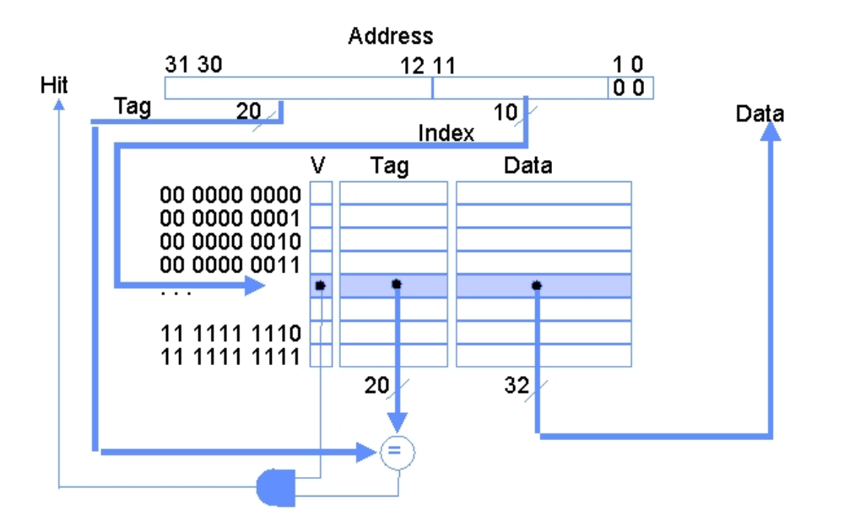
Example: Here is a direct-mapped cache with 1024 blocks.
Each block contains only a word.

Slide 16
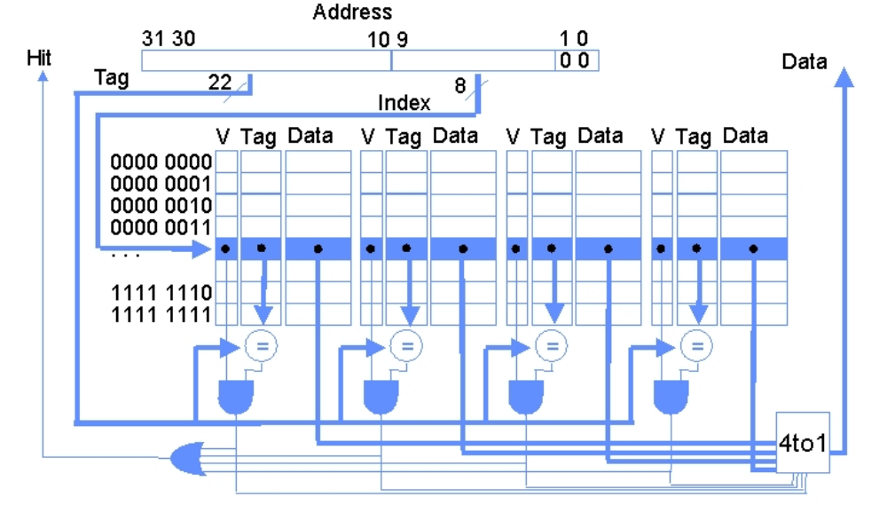
Example:
This is a 4-way set associative cache consisting
of 256 sets. Each block also contains 1 word.

Slide 17
Which block should be replaced on a cache miss ?
There are 3 primary strategies employed for selecting
which block to replace:
Random
Least recently used (LRU)
First in, first out (FIFO)

Slide 18
What happens on a write ?
Reads dominate processor cache accesses. All instruction
accesses are reads, and most instructions don’t write.
However, Amdahl’s law reminds us that high-performance
designs cannot neglect the speed of writes.
The write policies often distinguish cache designs. There
are two basic options when writing to the cache:
Write through → The information is written to both the
block in the cache and to the block in the lower-level
memory.
Write back → The information is written only to the
block in the cache. The modified cache block is written
to main memory only when it is replaced.

Slide 19
To reduce the frequency of writing back blocks on
replacement, a feature called the dirty bit is commonly
used. The bit indicates whether the block is dirty (modified
while in cache) or clean (not modified). If it is clean, the
block is not written back when it is replaced.
When the CPU must wait for writes to complete during
write through, the CPU is said to write stall. A common
optimization to reduce write stalls is a write buffer,
which allows the processor to continue as soon as the
data are written to the buffer.

Slide 20
Since the data are not needed on a write, there are two
options on a write miss:
Write allocate → The block is allocated on a write miss.
No-write allocate → The block is modified only in the
lower-level memory.
Either write miss policy could be used with write through or
write back. Normally, write-back caches use write allocate.
Write-through caches often use no-write allocate.

Slide 21
Cache Performance
Average memory access time =
Hit time + Miss rate ×Miss penalty
Example:
Which has the lower miss rate: a 16 KB instruction
cache or a 32 KB unified cache ? Assume 36% of
the instructions are data transfer instructions.
Assume a hit takes 1 clock cycle and the miss penalty
is 100 clock cycles. A load or store hit takes 1 extra
cycle on a unified cache if there is only one cache
port to satisfy two simultaneous requests. What is the
average memory access time in each cache ?

Slide 22
Sol:
Assume the following miss rates for different caches:
miss rate_{16KB instruction}=0.004
miss rate_{16KB data} =0.114
miss rate_{32KB unified}=0.0318
Percentage of memory accesses are instruction references
= 100/(100+36)=74%
Percentage of memory accesses are data references
=36/(100+36)=26%

Slide 23
Since 74 % of the memory accesses are instruction
references. Thus, the overall miss rate for the split
caches is
(74%×0.004)+(26%×0.114)=0.0324
Thus, a 32 KB unified cache has a slightly lower effective
miss rate than two 16 KB caches.

Slide 24
The average memory access time formula can be divided
into instruction and data accesses:
Average memory access time=
%instruction ×(Hit time + Miss rate × Miss penalty)+
%data ×(Hit time + Miss rate × Miss penalty)
Therefore, the time for each organization is
Average memory access time_{split}=
%74 ×(1 + 0.004 × 100)+%26 ×(1 + 0.114 × 100)=4.24
Average memory access time_{unified}=
%74×(1 + 0.0318× 100)+%26×(1+1+ 0.0318 × 100)=4.44
Hence, the split caches in this example have a better
average memory access time than the unified cache.
due to
structural
hazard

Slide 25
Miss penalty and out-of-order execution processors
For an out-of-order execution processor, the miss
penalty should be re-defined. It is not the full latency
of the miss to memory. Since it is not always necessary
to stall a CPU when a miss occurs, we re-define the
miss penalty as the non-overlapped latency when
the processor must stall.
Therefore, in this case,
Average memory access time =
Hit time + Miss rate ×
(Total Miss Latency - Overlapped miss latency)

Slide 26
Improving Cache Performance
Average memory access time =
Hit time + Miss rate ×Miss penalty
Based on the average memory access time formula,
we can organize cache optimizations into 4 categories:
Reducing the miss penalty
Reducing the miss rate
Reducing the miss penalty or miss rate via parallelism.
Reducing the time to hit in the cache.

Slide 27
Reducing Cache Miss Penalty
First miss penalty reduction technique: multilevel caches
The multilevel cache scheme can be used to extend
the cache size and match the CPU speed.
In the scheme, the 1st level cache can be small enough
to match the clock cycle time of the fast CPU. The 2nd
level cache can be large enough to capture many
accesses that would go to main memory, thereby
lessening the effective miss penalty.

Slide 28
Average memory access time =
Hit time_{L1} + Miss rate_{L1} ×Miss penalty_{L1}
Miss Penalty_{L1} =Hit time_{L2} + Miss rate_{L2} ×Miss penalty_{L2}
local miss rate
where
Miss rate_{Li}= the number of misses in the cache Li divided
by the number of memory accesses to the cache Li.
Therefore,
Average memory access time =Hit time_{L1} + Miss rate_{L1} ×(Hit time_{L2} + Miss rate_{L2} ×Miss penalty_{L2})

Slide 29
Example:
Given the data below, what is the impact of second-level
cache associativity on its miss penalty ?
Hit time_{L2} for direct mapped = 10 clock cycles.
Two-way set associativity increases hit time by 0.1
clock cycles to 10.1 clock cycles.
Local miss rate_{L2} for direct mapped = 25 %.
Local miss rate_{L2} for two-way associative = 20 %.
Miss penalty_{L2} = 100 clock cycles.

Slide 30
Sol:
Because
Miss Penalty_{L1} =Hit time_{L2} + Miss rate_{L2} ×Miss penalty_{L2}
We have
Miss Penalty_{1-way L1} =10+ 25% ×100=35.0 clock cycles
Miss Penalty_{2-way L1} =10.1+ 20% ×100=30.1 clock cycles
In reality, second level caches are almost always
synchronized with the first-level cache and CPU. Accordingly,
the second level hit time must be an integral number of
clock cycles. Here assume the second-level hit time becomes
11 cycles. The miss penalty then becomes
Miss Penalty_{2-way L1} =11+ 20% ×100=31 clock cycles

Slide 31
Second miss penalty reduction technique: critical word first and early restart
The technique is based on the observation that the CPU
normally needs just one word of the block at a time.
Here are two specific strategies:
1. Critical word first → Request the missed word first from
memory and send it to CPU as soon as it arrives; let the
CPU continue execution while filling the rest of the words
in the block.
2. Early restart → Fetch the words in normal order, but as
soon as the requested word of the block arrives, send it
to the CPU and let the CPU continue execution.

Slide 32
Third miss penalty reduction technique: giving priority to read misses over writes
With a write-through cache the most important
improvement is a write buffer of the proper size. Write
buffers, however, do complicate memory accesses
because they might hold the updated value of a location
needed on a read miss.

Slide 33
Example:
Look at this code sequence:
SW R3, 512(R0) ;M[512] ←R3 (cache index 0)
LW R1,1024(R0) ;R1 ← M[1024] (cache index 0)
LW R2, 512(R0) ;R2 ← M[512] (cache index 0)
Assume a direct-mapped, write-through cache that
maps 512 and 1024 to the same block, and a four-
word write buffer. Will the value in R2 always be
equal to the value in R3 ?

Slide 34
Sol:
SW R3, 512(R0)
The data in R3 are placed into the write buffer
after the store.
2. LW R1,1024(R0)
We have a read miss here. The content of MEM[1024]
therefore is also loaded into the cache block 0.
3. LW R2,512(R0)
We again have a read miss here. Note that, if the
write buffer has not completed writing to location 512
in memory, the read of location 512 will put the old,
wrong value into the cache block, and then into R2.
Without proper precaution, R3 would not be equal
to R2 !!

Slide 35
The simplest way out of this dilemma is for the
read miss to wait until the write buffer is empty.
The alternative is to check the contents of the
write buffer on a read miss, and if there are no
conflicts and the memory system is available, let
the read miss continue.

Slide 36
Fourth miss penalty reduction technique: merging write buffer
This technique combines writes to sequential words
into a single block to create a more efficient transfer
to memory.

Slide 37
Write
Address
100
108
116
124
MEM[100]
MEM[108]
MEM[116]
MEM[124]
without
write-merging
Write
Address
100
MEM[100] | MEM[108] | MEM[116] | MEM[124]
with
write-merging

Slide 38
Fifth miss penalty reduction technique: victim caches
One approach to lower the miss penalty is to remember
what was discarded in case it is needed again. Since
the discarded data has already been fetched, it can
be used again at small cost.
Such “recycling” requires a small, fully associative cache,
termed victim cache. The cache contains only blocks
that are discarded from a cache because of a miss,
and are checked on a miss to see if they have the desired
data before going to the next lower level memory.

Slide 39
Reducing Miss Rate
We first start with a model that sorts all misses into
3 simple categories:
Compulsory → The very first access to a block cannot
be in the cache, so the block must be brought
into the cache.
Capacity → If the cache cannot contain all the blocks
needed during execution of a program, capacity
misses will occur because of blocks being discarded
and later fetched.
Conflict → If the block placement strategy is set
associative or direct mapped, conflict misses will
occur because a block may be discarded and later
retrieved if too many blocks map to its set.

Slide 40
Compulsory misses are those that occur in an infinite cache.
Capacity misses are those that occur in a fully associative
cache.
Conflict misses are those that occur going from fully
associative to 8-way associative, 4-way associative, and so on.

Slide 41
First miss rate reduction technique: larger block size
The simplest way to reduce miss rate is to increase the
block size. Larger block sizes will reduce compulsory
misses. This reduction occurs because larger block size
take advantage of spatial locality.
However, they reduce the number of blocks in the cache.
Therefore, larger blocks may increase conflict misses and
even capacity misses if the cache is small.

Slide 42
Example:
The following table shows the actual miss rates for 5
different-sized caches. Assume the memory system
takes 80 clock cycles of overhead and then delivers 16
bytes every 2 clock cycles. Thus, it can supply 16 bytes
in 82 clock cycles, 32 bytes in 84 clock cycles, and so on.
Which block has the smallest average memory access time ?
Block Size | Cache Size
 | 4K | 16K | 64K | 256K
16 | 8.57% | 3.94% | 2.04% | 1.09%
32 | 7.24% | 2.87% | 1.35% | 0.70%
64 | 7.00% | 2.64% | 1.06% | 0.51%
128 | 7.78% | 2.77% | 1.02% | 0.49%
256 | 9.51% | 3.29% | 1.15% | 0.49%

Slide 43
Sol:
Recall that
Average memory access time = Hit time + Miss rate ×Miss penalty
Assume the hit time = 1 clock cycle. Then, for a
256-byte block in a 256 KB cache, we have
Average memory access time = 1+ 0.49% × 112 =1.549 clock cycles.
The following table shows the average memory access time
for all block and cache sizes. The boldfaced entries show
the fastest block size for a given cache size.
Block Size | Miss Penalty | Cache Size
 |  | 4K | 16K | 64K | 256K
16 | 82 | 8.027 | 4.231 | 2.673 | 1.894
32 | 84 | 7.082 | 3.411 | 2.134 | 1.588
64 | 88 | 7.160 | 3.323 | 1.933 | 1.449
128 | 96 | 8.469 | 3.659 | 1.979 | 1.470
256 | 112 | 11.651 | 4.685 | 2.288 | 1.549

Slide 44
Second miss rate reduction technique: larger caches
The obvious way to reduce capacity misses is to increase
capacity of the cache. The obvious drawback is longer
hit time and higher cost.

Slide 45
Third miss rate reduction technique: higher associativity
Miss rate can be reduced by increasing associativity.
There are two rules of thumb for increasing the
associativity:
8-way set associative is as effective as fully associative.
A direct –mapped cache of size N has about the same
miss rate as a 2-way set associative cache of size N/2.
(2:1 cache rule of thumb)
The drawback of this method is that the hit time
may be increased as the associativity becomes higher.

Slide 46
Fourth miss rate reduction technique: way prediction and pseudoassociative caches
way prediction
In way prediction, extra bits are kept in the cache to
predict the block (i.e., way) within the set of the next
cache access. A miss results in checking the other
blocks for matches in subsequent clock cycles.
In addition to improving performance, way prediction
can reduce power for embedded applications. By only
supplying power to the half of tags that are expected
to be used, the MIPS R4300 series lowers power
consumption with the same benefits.

Slide 47
Pseudoassociative
In this technique, accesses proceed just as in the
direct-mapped cache for a hit. On a miss, however,
before going to the next lower level of the memory
hierarchy, a second entry is checked to see if it
matches there. A simple way is to invert the most
significant bit of the index field to find another
block in the “pseudoset.”
In fact, pseudoassociative have one fast
and one slow hit time — corresponding to a regular hit
and a pseudohit — in addition to the miss penalty.
Hit time
Pseudohit time
Miss penalty

Slide 48
Fifth miss rate reduction technique: compiler optimizations
This technique reduces miss rates without any hardware
changes. A simple example is the loop exchange.
Some programs have nested loops that access data in
memory in nonsequential order. Simply exchanging
the nesting of the loops can make the code access the
data in the order they are stored.
for (j=0;j<100;j=j+1)
for(i=0;i<5000;i=i+1)
x[i][j]=2*x[i][j]
for (i=0;i<5000;i=i+1)
for(j=0;j<100;j=j+1)
x[i][j]=2*x[i][j]
➔

Slide 49
Reducing Cache Miss Penalty or Miss rate via Parallelism
Here we describe three techniques that overlap the
execution of instructions with activity in memory
hierarchy.

Slide 50
First miss penalty/rate reduction technique: nonblocking caches to reduce stalls on cache misses
For pipelined computers that allow out-of-order
completion, the CPU need not stall on a cache miss.
A nonblocking cache escalates the potential benefits
of such a scheme by allowing the data cache to
continue to supply cache hits during a miss.
A subtle and complex option is that the cache may further
lower the effective miss penalty if it can overlap multiple
misses: a “hit under multiple miss” optimization.

Slide 51
Second miss penalty/rate reduction technique: hardware prefetching of instructions and data
Instruction prefetching is frequently done in hardware
outside of cache. Typically, the processor fetches
two blocks on a miss: the requested block and the
next consecutive block. The requested block is
placed in the instruction cache when it returns, and
the prefetched block is placed into the instruction
stream buffer.
If the requested block is present in the instruction stream
buffer, the original cache request is canceled, the block
is read from the stream buffer, and the next prefetch
request is issued.

Slide 52
Example:
What is the effective miss rate of UltraSPARC III using
prefetching ? How much bigger a data cache would be
needed in the UltraSPARC III to match the average access
time if prefetching were removed ? It has a 64 KB data
cache. Assume prefetching reduces the data miss rate
by 20%. The following table gives the number of misses
per 1000 instructions for 64KB, 128KB and 256KB data
caches. Also assume the number of data references out
of 1000 instructions is 220. In addition, hit time = 1 clock
and miss penalty=15 clocks.
Data cache size | 64KB | 128KB | 256KB
Miss per 1000 instructions | 36.9 | 35.3 | 32.6

Slide 53
Sol:
Based on the table, we see that the number of misses
per 1000 instructions for a 64KB data cache is 36.9.
Since the number of data accesses per 1000 instructions
is 220, from
Misses
Memory access
=
Miss rate
×
Instruction
Instruction
we know that the miss rate for a 64 KB data cache is
given by
Miss rate =
36.9
=16.7%
1000 ×220/1000

Slide 54
We assume it takes 1 extra clock cycle if the data miss
the cache but are found in the prefetch buffer. Here is
the revised formula for computing the average memory
access time.
Extra clock
cycle for
prefetch buffer
Average memory access time_{prefetch} = Hit time +
Miss rate × Prefetch hit rate × 1 +
Miss rate × (1 - Prefetch hit rate) × Miss penalty
Therefore,
Average memory access time_{prefetch} = 1 + 16.7% × 20% × 1 +
16.7% × (1 – 20%) × 15= 3.046

Slide 55
To find the effective miss rate when the average memory
access time is 3.046, we first note that
Average memory access time = Hit time + Miss rate ×Miss penalty
Therefore,
Effective Miss rate =(3.046-Hit time)/Miss penalty=(3.046-1)/15=13.6%
The table gives the misses per 1000 instructions of a 256 KB
data cache as 32.6, yielding a miss rate of 32.6/(22% × 1000)
=14.8%
If the prefetching reduces the miss rate by 20%, then a 64KB
data cache with prefetching outperforms a 256 KB cache
without it.

Slide 56
Third miss penalty/rate reduction technique: compiler-controlled prefetching
An alternative to hardware prefetching is for the compiler
to insert prefetch instructions to request the data before
they are needed. There are two flavors of prefetch:
Register prefetch will load the value into a register
Cache prefetch loads data only into the cache and
not register.

Slide 57
Reducing Hit Time
Hit time is critical because it affects the clock rate
of the processor.
A fast hit time is multiplied in importance beyond the
average memory access time formula because it helps
everything.

Slide 58
First hit time reduction technique: small and simple caches
Small cache →
Smaller hardware is faster, and a small cache certainly
helps the hit time.
Simple cache→
The direct-mapped cache can reduce the hit time because
the tag check and the data transmission can be overlapped
in the scheme.

Slide 59
Second hit time reduction technique: avoiding address translation during indexing of the cache
Even a small and simple cache must cope with the
translation of a virtual address from the CPU to a
physical address to access memory.
The hit time therefore can be reduced if we use the
virtual address directly for indexing cache and tag
comparison. Such caches are termed virtual caches.

Slide 60
Using the virtual address directly is not popular because
of the following reasons:
Protection: Page-level protection is checked as the
part of virtual to physical address translation, and
it must be enforced no matter what.
Process-dependent: Every time a process is switched,
the virtual addresses refer to different physical
addresses, requiring the virtual cache to be flushed.
Aliasing: Operating systems and user programs may
use two different virtual addresses for the same
physical address. These duplicate addresses may
result in two copies of the same data in a virtual cache;
if one is modified, the other will have the wrong value.

Slide 61
Third hit time reduction technique: pipelined cache access
This technique is simply to pipeline cache access so that
the effective latency of a first-level cache hit can be
multiple clock cycles, giving fast cycle time and slow
hit.
This split increases the number of pipeline stages, leading
to greater penalty on mispredicted branches and more
clock cycles between the issue of the load and the use
of the data.

Slide 62
Memory Technology
There are two basic memory technologies considered here: static RAMs (SRAMs) and dynamic RAMs (DRAMs).
Virtually all desktop or server computers since 1975 used DRAMs for main memory, and virtually all used SRAMs for cache.

Slide 63
In DRAM designs the emphasis is on cost per bit and capacity.
SRAM designs are concerned with speed and capacity.

Slide 64
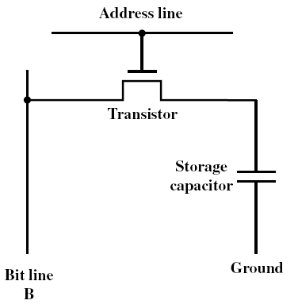
DRAM Storage Cell

Slide 65
DRAM Operation
Address line active when bit read or written
Logic ‘1’ closes transistor switch (i.e., current flows)
Write
  Voltage to bit line – High for 1 low for 0
  Signal address line – Controls transfer of charge to capacitor
Read
  Address line selected – transistor turns on
  Charge from capacitor fed via bit line to sense amplifier
  Compares with reference value to determine 0 or 1

Slide 66
DRAM Refreshing
Two things discharge a DRAM capacitor:
  1. Data read
  2. Leakage current
We therefore need refreshing (or pre-charging) capacitor even when powered and idle (once every few milliseconds).
Refresh circuit included on chip:
– Even with added cost, still cheaper than SRAM cost.
Refresh process involves disabling chip, then reading data
and writing it back.
The refreshing process will slow down the performance of
DRAM.

Slide 67
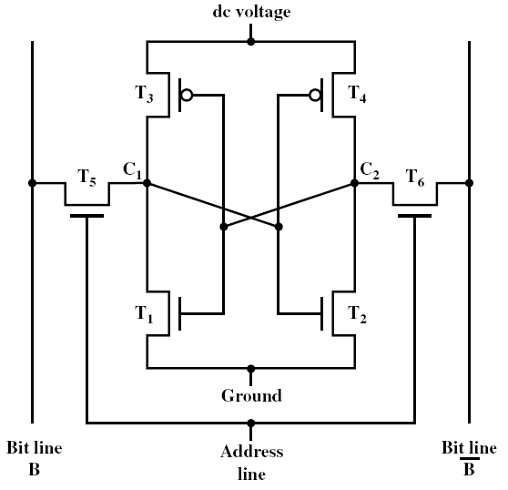
SRAM Storage Cell

Slide 68
SRAM Operation
Transistor arrangement gives stable logic state
State 1
  C1 high, C2 low
  T1 T4 off, T2 T3 on
State 0
  C2 high, C1 low
  T2 & T3 off, T1 & T4 on
Address line transistors
  T5 & T6 act as switches connecting cell
Write – apply value to B & compliment to B
Read – value is on line B
It is not necessary to refresh the storage cell in SRAM.

Slide 69
DRAM Internal Organization
As early DRAM grew in capacity, the cost of a package
with all the necessary lines was an issue.
The solution was to multiplex the address lines, thereby
cutting the address pins in half.
One-half of the address is sent first, called the row access
strobe (RAS). The other half of the address, sent during
the column access strobe (CAS), follows it.

Slide 70
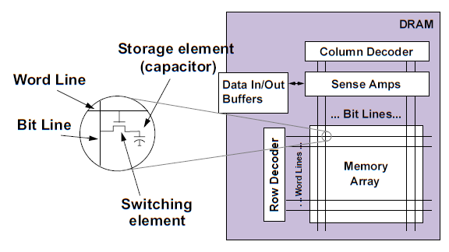

Slide 71
Accessing DRAM
To accessing DRAM, a memory controller is required.
Use a read operation as an example. The memory
controller first accepts an address from CPU. It then
translates the address to RAS and CAS for accessing
DRAM. After that, the memory controller obtains data
From DRAM, and delivers data back to CPU.
Step-by-step illustration of this example is shown below.

Slide 72
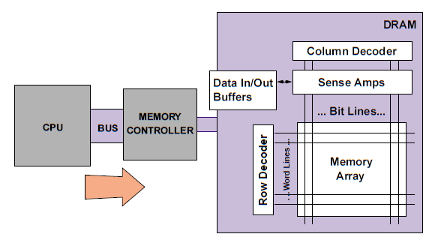
CPU sends an address to memory controller.

Slide 73
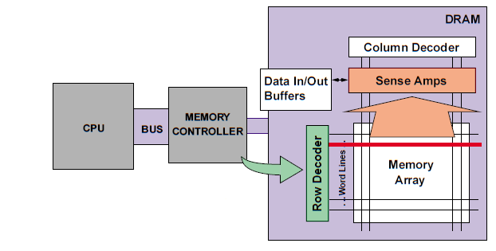
Memory controller sends a RAS to DRAM.

Slide 74
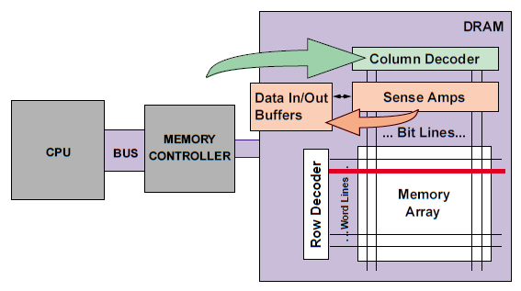
Memory controller sends a CAS to DRAM.

Slide 75
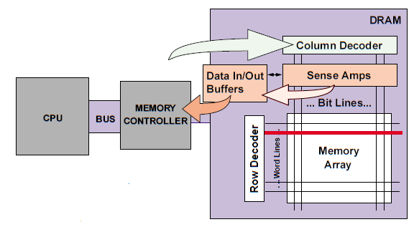
Memory controller obtains data from DRAM.

Slide 76
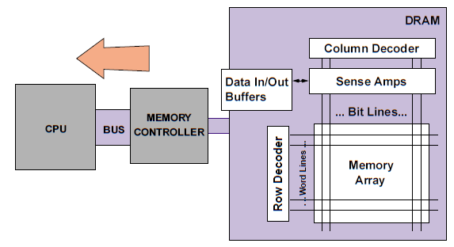
Memory controller sends the data to CPU.

Slide 77
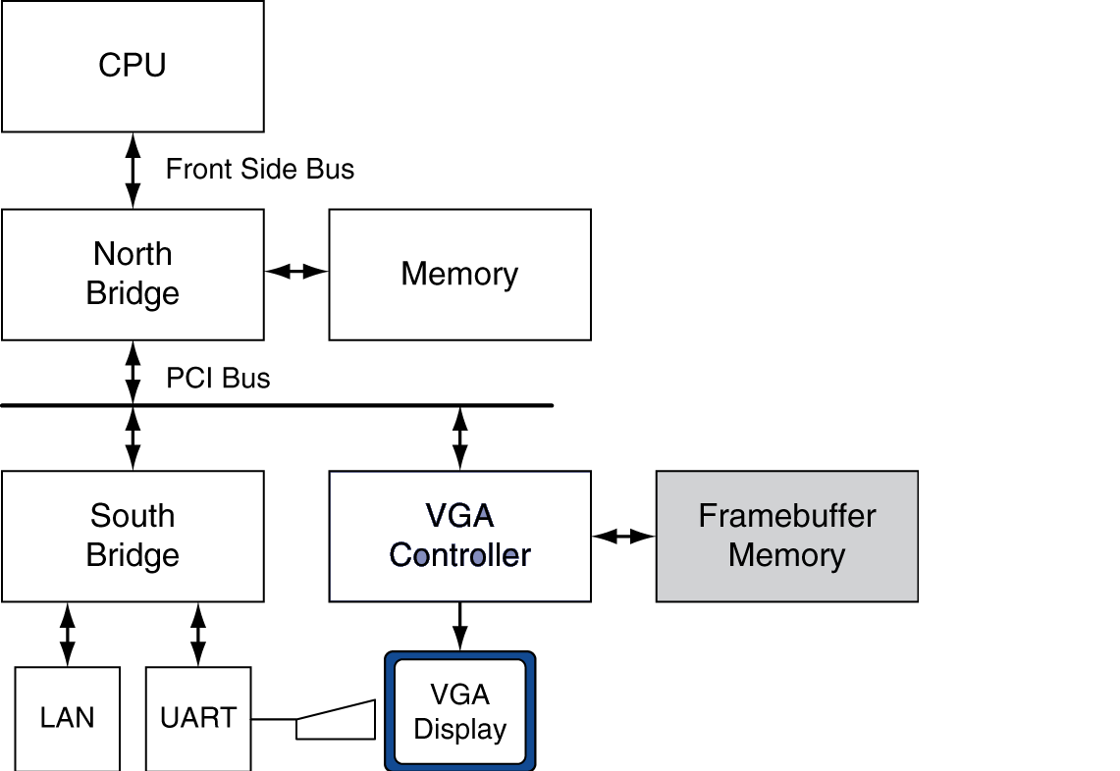
The memory controller is usually included in the
northbridge chip in the PC mother board.

Slide 78
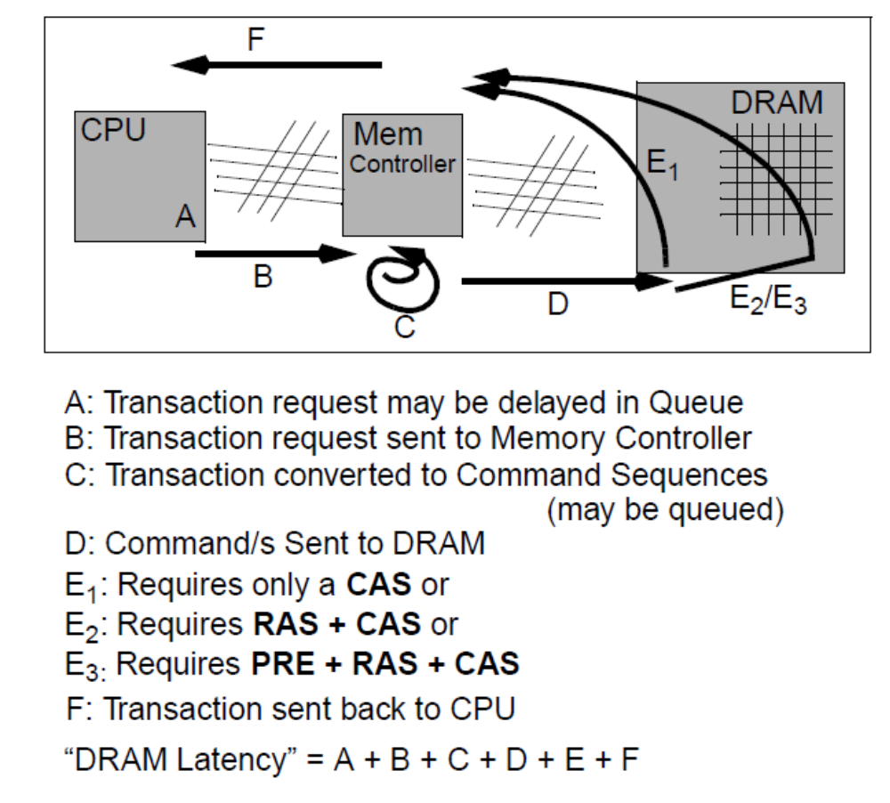
DRAM Latency

Slide 79
DRAM Improvement
Basic DRAM has an asynchronous interface to the
memory controller, and hence every transfer involved
overhead to synchronized with the memory controller.

Slide 80
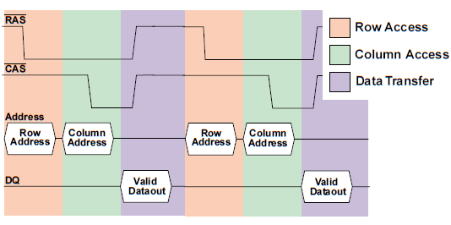
Read timing for basic DRAM.

Slide 81
In synchronous DRAM (SDRAM), a clock signal is added
to the DRAM interface so that repeated transfers would
not that overhead. SDRAMs typically have a
programmable register to hold the number of bytes
requested, and hence can send many bytes over
several cycles per request.

Slide 82
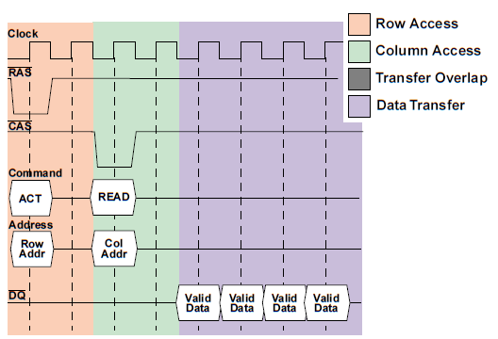
Read timing for synchronous DRAM (SDRAM).

Slide 83
The next major DRAM innovation is to transfer data
on both rising edge and falling edge of the DRAM
clock signal. This optimization is called double data
rate (DDR).

Slide 84
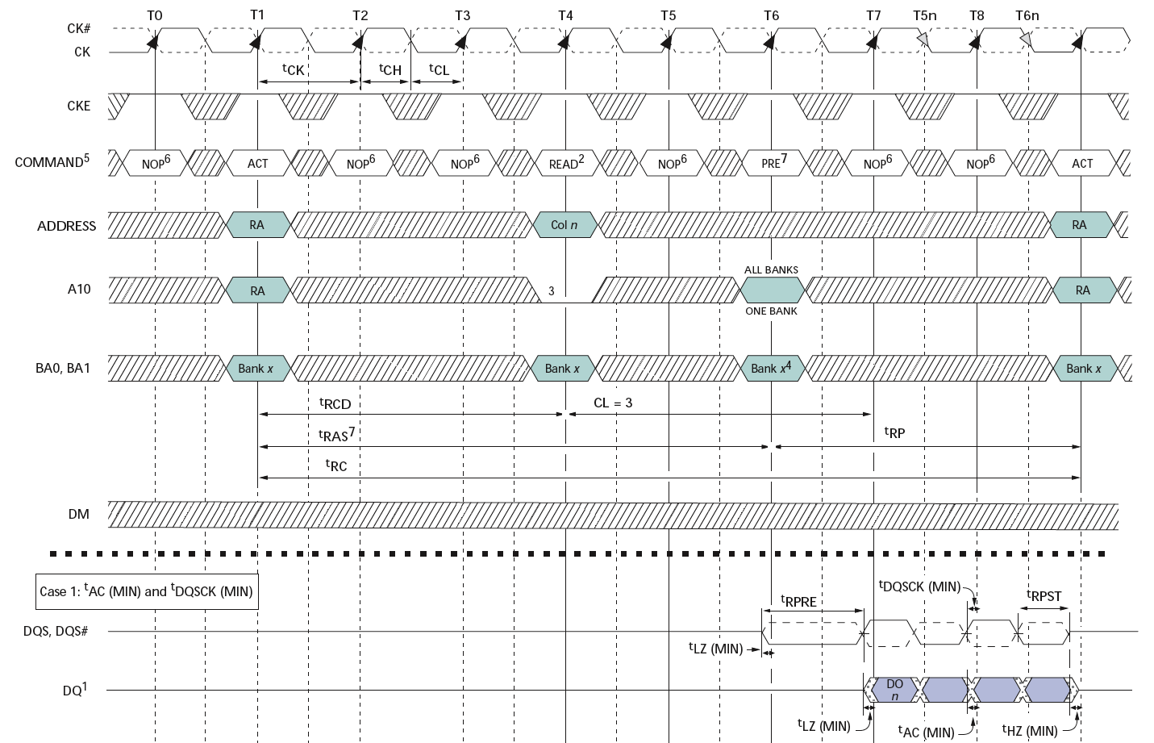
Double-Data Rate (DDR2) DRAM
200MHz Clock
Row
Column
Precharge
Row’
Data
400Mb/s Data Rate
[ Micron, 256Mb DDR2 SDRAM datasheet ]

Slide 85
Main Memory and Organizations for Improving Performance
Performance measures of main memory emphasize
both latency and bandwidth.
The memory bandwidth is the number of byte read or
written per unit time.
Although caches are interested in low-latency memory,
it is generally easier to improve memory bandwidth
with new organizations than it is to reduce latency. With
popularity of L2 caches and their larger block sizes, main
memory bandwidth becomes important to caches as well.

Slide 86
In this section we examine techniques for organizing
memory to improve bandwidth.
Assume the performance of basic memory organization is
4 clock cycles to send the address
56 clock cycles for the access time per word
4 clock cycles to send a word of data
Given a cache block of 4 words, and that a word is 8 bytes,
the miss penalty is 4 ×(4+56+4)=256 cycles, with a
memory bandwidth of (8 × 4)/256=1/8 byte per clock cycle.

Slide 87
Three different memory systems.
One-word-wide
memory organization
Wide memory
organization
Interleaved memory
organization
CPU
CPU
CPU
Cache
Cache
L1
Cache
Memory
Memory
Bank 0
Memory
Bank 1
Memory
Bank 2
Memory
Bank 3
Cache L2
Memory

Slide 88
First technique for higher bandwidth: wider main memory
First-level caches are often organized with a physical
width of 1 word because most CPU accesses are that
size. Doubling or quadrupling the width of the cache
and memory will therefore doubling or quadrupling
the memory bandwidth.
With a main memory width of 2 words, the miss penalty
in our example will drop from 4 ×(4+56+4)=256 cycles
to 2×(4+56+4)=128 cycles. At 4 word wide the miss
penalty is just 1×(4+56+4)=64 cycles.
Since main memory is traditionally expandable, a drawback
to wide memory is that the minimum increment is doubled
or quadrupled when the width is doubled or quadrupled.

Slide 89
Second technique for higher bandwidth: simple interleaved memory
Memory chips can be organized in banks to read or
write multiple words at a time rather than a single word.
The banks are often 1 word wide so that the width of the
bus and the cache need not change, but sending addresses
to several banks permits them all to read simultaneously.
For example, sending an address to 4 banks yields a miss
penalty of 4+56+(4×4)=76 clock cycles.
Banks are also valuable to writes. Banks allow 1 clock cycle
for each write, provided the writes are not destined to the
same band. Such a memory organization is especially
important for write through.

Slide 90
We assume the addresses of the four banks are
interleaved at the word level.
Bank i has all words whose address modulo 4 is i, i=0,1,2,3.
Word
Address
Word
Address
Word
Address
Word
Address
Bank 0
Bank 1
Bank 2
Bank 3
0
4
8
12
1
5
9
13
2
6
10
14
3
7
11
15
4-way interleaved memory

Slide 91
Example:
Consider the following description of a computer and its
cache performance :
Block size=1 word
memory bus width = 1 word
miss rate = 3%
memory access per instruction = 1.2
cache miss penalty = 64 cycles
average CPI (ignoring cache misses)=2
If we change the block size to 2 words, the miss rate falls
to 2%, and a 4-word block has a miss rate of 1.2%.
What is the improvement in performance of interleaving
2 ways and 4 ways versus doubling the width of memory
and bus ?

Slide 92
memory access per instruction
Sol:
The CPI for the base computer using 1-word block is
2+(1.2×3%×64)=4.30
Increasing the block size to 2 words gives the following
options:
64-bit bus and memory, no interleaving =2+(1.2×2%×2×64)=5.07
64-bit bus and memory, interleaving = 2+(1.2×2%×(4+56+8))=3.63
128-bit bus and memory, no interleaving = 2+(1.2×2%×1×64)=3.54
If we increase the block size to four, the following is
obtained:
64-bit bus and memory, no interleaving =2+(1.2×1.2%×4×64)=5.69
64-bit bus and memory, interleaving = 2+(1.2×1.2%×(4+56+16))=3.09
128-bit bus and memory, no interleaving = 2+(1.2×1.2%×2×64)=3.84
miss penalty
miss penalty
for two words
miss rate
1 word =8 bytes = 64 bits

Slide 93
Virtual memory
The main memory can act as a “cache” for the secondary
storage, usually implemented with magnetic disks. This
technique is called virtual memory. There are two
motivations for virtual memory: to allow efficient and
safe sharing of memory among multiple programs, and to
remove the programming burdens of a small, limited
amount of main memory.
Several general memory ideas about caches are
analogous to virtual memory, although many of the
terms are different.
Page or segment is used for block, and
page fault or address fault is used for miss.

Slide 94
With virtual memory, the CPU produces virtual addresses
that are translated by a combination of software and
hardware to physical addresses, which access the memory.
This process is called memory-mapping or
address translation.
Virtual
Address
Physical
Address
0
4K
8K
12K
A
B
C
D
C
A
B
0
4K
8K
12K
16K
20K
24K
28K
32K
Physical memory
Virtual memory
D
Disk

Slide 95
Four memory hierarchy questions revisited
Where can a block be placed in a main memory ?
The miss penalty for virtual memory is very high.
To reduce the miss rate, the operating systems allow
blocks to be placed anywhere in main memory.

Slide 96
How is a block found if it is in the main memory ?
We need to translate the virtual address to physical
address. This can be done using the page table.
Virtual Address
Virtual Page Number | Page Offset
Main Memory
Page
Table
Physical
Address

Slide 97
Which block should be replaced on a virtual
memory miss ?
The LRU is usually used to minimize page faults.
To help the operating system estimate LRU, many
processors provide a use bit or reference bit, which
is logically set whenever a page is accessed.
What happens on a write ?
Since the cost of an unnecessary access to the disk is
very high, the write strategy is always write back.
However, virtual memory systems usually include a dirty
bit. It allows blocks to be written to disk only if
they have been altered since being read from disk.

Slide 98
Techniques for fast address translation
Page tables usually have large size. For example,
given a 32-bit virtual address, 4 KB pages, and 4 bytes
per page table entry, the size of the page table
is (2³²/2¹²) ×4=4MB. Therefore, the address translation
may be very slow.
One solution to this problem is also rely on the
principle of locality;
if the accesses have locality, then the address translations
for the accesses must also have locality.
We then can use a special cache, called translation
lookaside buffer (TLB), for address translation.

Slide 99
A TLB entry is like a cache entry where the tag holds
portions of the virtual address. The data portion holds:
physical page number
protection field (for page-level protection)
valid bit
use bit (optional, for LRU)
dirty bit (optional, indicates whether the corresponding
page is dirty or not, for write back).

Slide 100
An example of memory hierarchy going from virtual address
to L1 cache access
Virtual address <32>
Virtual page number <20>
Page offset <12>
Fully-Connected TLB tag <20>
TLB data <20>
Physical page number <20>
Page offset <12>
Physical address tag <16>
Cache index <14>
<2>
Byte offset
L1 cache tag <16>
L1 data <32>
=?
To CPU or L1

Slide 101
The overall picture of a hypothetical memory hierarchy
going from virtual address to L2 cache access
Virtual address <64>
Virtual page number <51>
Page offset <13>
TLB tag compare address <43>
TLB index <8>
L1 cache index <7>
Block Offset <6>
To CPU
TLB tag <43>
TLB data <28>
L1 cache tag <28>
L1 data <512>
=?
L1 tag compare address <28>
=?
To CPU
Physical address <41>
L2 tag compare address <19>
L2 cache index <16>
Block offset <6>
To CPU
L2 cache tag <19>
L2 data <512>
=?
To CPU or L1

